Slide 1

NativeScript Tooling

Slide 2


NativeScript Tooling

Slide 3

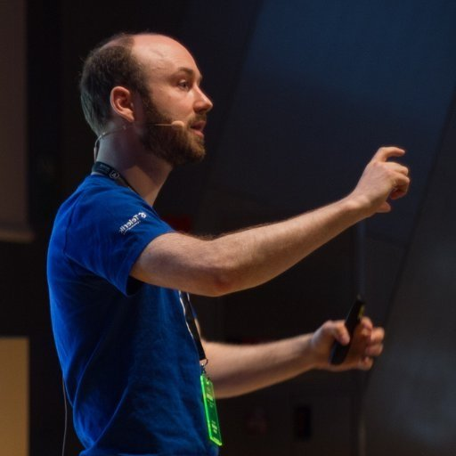
Rob Lauer
Sr Manager, Developer Relations
@RobLauer
Sebastian Witalec
Developer Advocate
@SebaWita

Slide 4


What can we cover today?
Visual Tooling for {N}
NativeScript CLI

Slide 5

DEMO

Slide 6
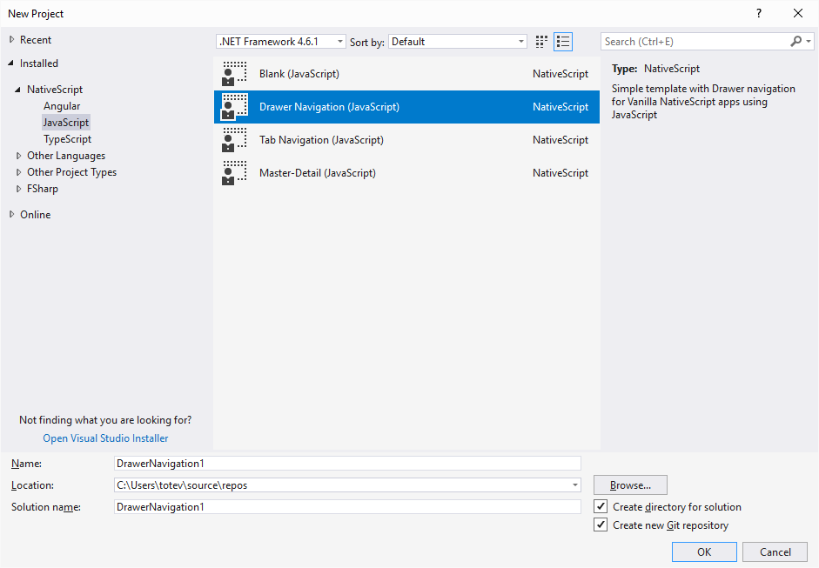
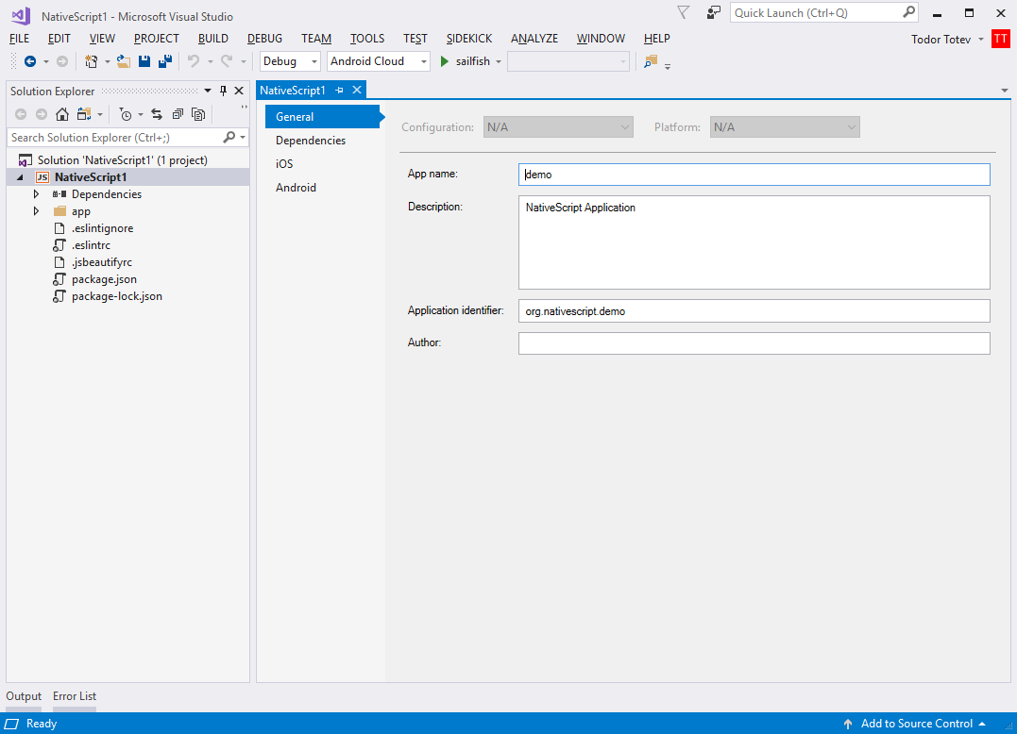
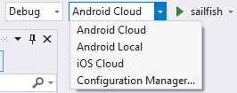
Sidekick for Visual Studio

Slide 7

{N} Tooling Resources
NativeScript CLI @ docs.nativescript.org
Marketplace @ market.nativescript.org
Playground @ play.nativescript.org
Sidekick @ nativescript.org/nativescript-sidekick
Theme Builder @ nativescriptthemebuilder.com

